Slide 1
IPC (HW)
KeyStone Training
Notes:
NEW

Slide 2
Agenda
Inter-Processor Communication
Inter-Processor Host Interrupt
NMI Event Generation
CSL API (IPC, IPC Host, NMI)
Notes:
NEW

Slide 3
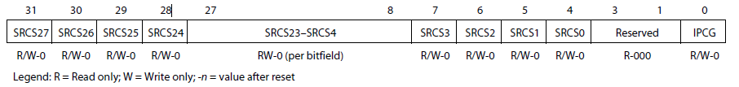
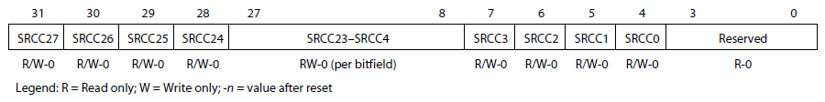
Inter-Processor Communication
IPC Generation Register (IPCGRx), x=0..7
IPC Acknowledgement Register (IPCARx), x=0..7
28 different sources of interrupts
2 Registers per core to control Inter-DSP Interrupts
  IPCG (In IPCGRx)
    Write ‘1’ to IPCG triggers an interrupt to corresponding GEM
    Write ‘0’ and Reads have no effect
  SRCSx (In IPCGRx)
    SW method to tell what caused the interrupt
    Usage is completely SW defined
    Write of ‘1’ is sticky and is read back as ‘1’ until cleared, Sets both SRCSx and the corresponding SRCCx bits.
    Write of ‘0’ has no effect
    Reads return the current value of the bit
  SRCCx (In IPCARx)
    Write of ‘1’ clears SRCSx in IPCARx
    Write of ‘0’ or read has no effect
Notes:
NEW

Slide 4
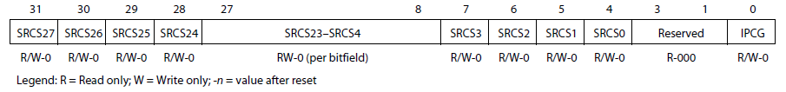
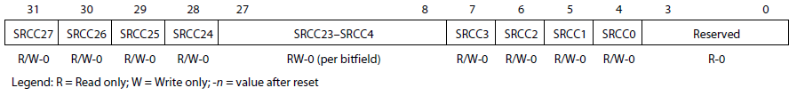
Inter-Processor Host Interrupt
IPC Host Generation Register (IPCGRH)
IPC Host Acknowledgement Register (IPCARH)
Drive external host interrupt/event output (HOUT).
2 Registers to control Inter-Processor Host Interrupts
  IPCG (In IPCGRH)
    Write ‘1’ to IPCG triggers an interrupt to external host device
    Write ‘0’ and Reads have no effect
  SRCSx (In IPCGRH)
    SW method to tell what caused the interrupt
    Usage is completely SW defined
    Write of ‘1’ is sticky and is read back as ‘1’ until cleared, Sets both SRCSx and the corresponding SRCCx bits.
    Write of ‘0’ has no effect
    Reads return the current value of the bit
  SRCCx (In IPCARH)
    Write of ‘1’ clears SRCSx in IPCARx
    Write of ‘0’ or read has no effect
Notes:
NEW

Slide 5
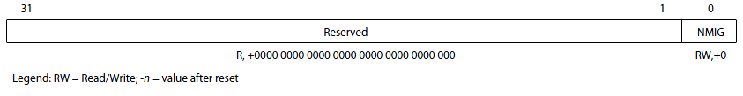
NMI Event Generation
NMI Event Generation (NMIGRx)
Generate an NMI event to the corresponding core
  NMIG (bit “0”)
    Write ‘1’ creates NMI pulse to the corresponding core
    Write ‘0’ and Reads have no effect
Notes:
NEW

Slide 6
IPC CSL API (csl_ipcAux.h)
void CSL_IPC_genGEMInterrupt (index, srcId);
  This function set’s the IPCG bit of the IPC Generation Register (IPCGRx)
Uint32 CSL_IPC_isGEMInterruptSourceSet (index, srcId);
  This function checks if the SRCSx bit of the IPCGRx register is set.
Uint32 CSL_IPC_isGEMInterruptAckSet (index, srcId);
  This function checks if the SRCCx bit of the IPCARx register is set.
void CSL_IPC_clearGEMInterruptSource (index, srcId);
  This function clears the interrupt source IDs by setting the SRCCx bit of the IPC Acknowledgment Register (IPCARx) and SRCSx bit of IPC Generation Register (IPCGRx) corresponding to the GEM index and Source ID specified.
Notes:
NEW

Slide 7
IPC Host CSL API (csl_ipcAux.h)
void CSL_IPC_genHostInterrupt (srcId);
  This function sets the IPCG bit of the Host IPC Generation Register (IPCGRH) to create an interrupt pulse on the device pin.
Uint32 CSL_IPC_isHostInterruptSourceSet (srcId);
  This function checks if the SRCSx bit of the IPCGRH register is set.
Uint32 CSL_IPC_isHostInterruptAckSet (srcId);
  This function checks if the SRCCx bit of the IPCARH register is set.
void CSL_IPC_clearHostInterruptSource (srcId);
  This function clears the interrupt source IDs by setting the SRCCx bit of the Host IPC Acknowledgment Register (IPCARH) and SRCSx bit of Host IPC Generation Register (IPCGRH) corresponding to the Source ID specified.
Notes:
NEW

Slide 8
NMI CSL API (csl_ipcAux.h)
void CSL_IPC_genNMIEvent (index);
  This function sets the NMIG bit of the NMI Generation Register (NMIGRx) to create an NMI pulse to the GEM corresponding to the index specified here.
Notes:
NEW

Slide 9
For More Information
For more information, refer to the
KeyStone Architecture Interrupt Controller (INTC), Literature Number: SPRUGW4
Notes:
NEW

